Slide 1
Image Processing with CUDA
Jia Tse
Uinversity of Nevada, 2012
2017.03.23
Sehwan Ki
Dept. of Electronic Engineering, KAIST

Slide 2
Contents
Introduction
Characteristics of Image Processing
Image processing and CUDA
Gaussian Blur
Sobel Edge Detection
Results
Conclusion

Slide 3
Introduction

Slide 4


Characteristics of Image processing
Image processing happens on the entire image, and the same steps are applied to every pixel of the image.
A lot of repetition of the same work = Single Instruction Multiple Data
Thus, GPU programming(CUDA) can be easily and efficiently applied to the Image Processing.
GRAY = 0.2989 * R + 0.5870 * G + 0.1140 * B
Pixel Operation !!!

Slide 5
Image Processing and CUDA

Slide 6
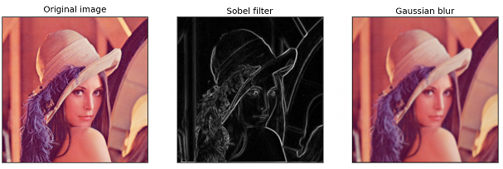
Filtering Operation
Pass Only High frequency
Pass Only Low frequency
Edge Detection
Noise Reduction

Slide 7
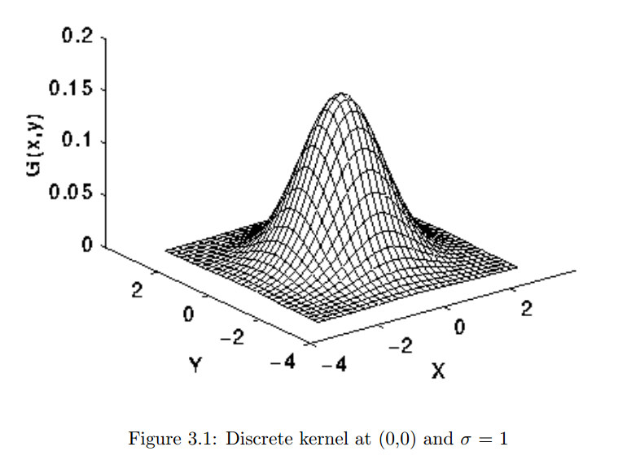
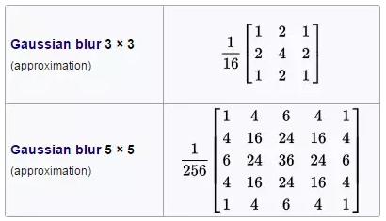
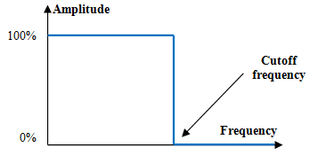
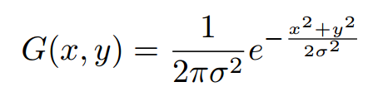
Gaussian Blur
Gaussian Blur
Type of convolution most commonly used to reduce image noise and detail.
By applying the image through a low pass filter.
To resolve the problem of simple low pass filter which can not consider the pixel distance, Gaussian Blur filter reduces the magnitude of high frequency coefficients proportional to their frequencies.
Simple Low Pass filter

Slide 8

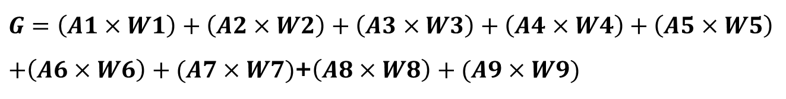


Gaussian Blur: Implementation with CUDA
Algorithm
Original Image
 |  | G
3$×$3
Gaussian Filter
A1 | A2 | A3
A4 | A5 | A6
A7 | A8 | A9
W1 | W2 | W3
W4 | W5 | W6
W7 | W8 | W9
$$∙$$
$$G=\left(A1×W1\right)+\left(A2×W2\right)+\left(A3×W3\right)+\left(A4×W4\right)+\left(A5×W5\right)$$
$+\left(A6×W6\right)+(A7×W7)$+$\left(A8×W8\right)+(A9×W9)$

Slide 9
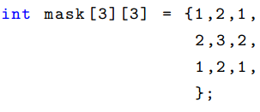
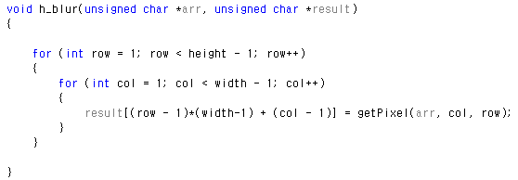
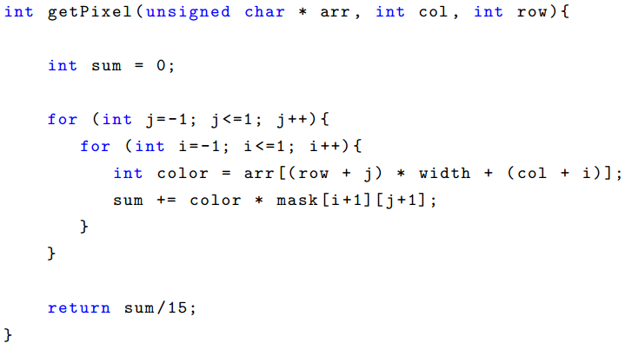
Gaussian Blur: Implementation with CUDA
Implementation with C only using CPU

Slide 10
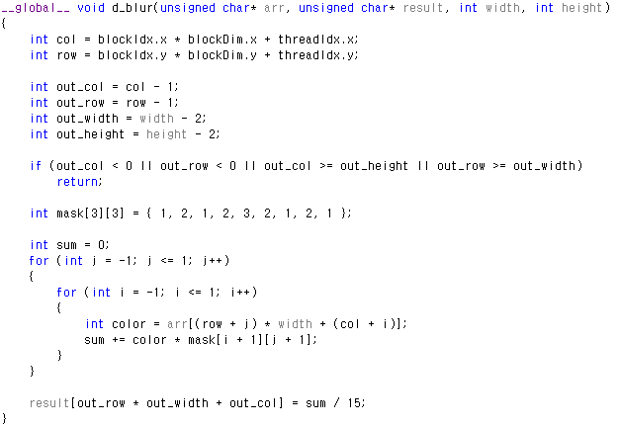
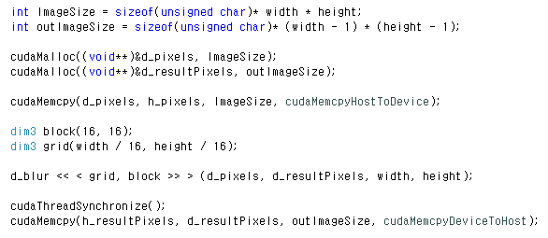
Gaussian Blur: Implementation with CUDA
Implementation with CUDA

Slide 11
Gaussian Blur: Implementation with CUDA
Implementation with CUDA
This calls a CUDA Library to allocate memory on the device to d_pixels and d_resultPixels.
outImageSize
ImageSize

Slide 12
Gaussian Blur: Implementation with CUDA
Implementation with CUDA
Copies the contents of the host memory to the device memory referenced by d_pixels

Slide 13
Gaussian Blur: Implementation with CUDA
Implementation with CUDA
Declares block sizes of 16x16 for 256 threads per block

Slide 14
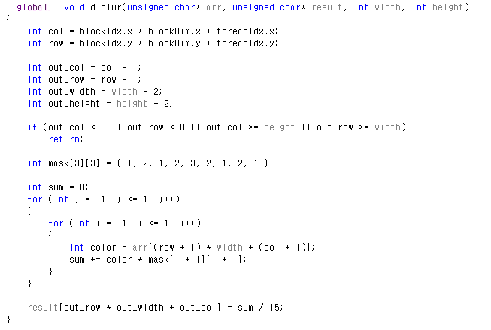
Gaussian Blur: Implementation with CUDA
Implementation with CUDA
This tells us that we want to have a (width/16) x (height/16) size grid

Slide 15
Gaussian Blur: Implementation with CUDA
Implementation with CUDA
Invokes the device method d_blur passing in the parameters

Slide 16
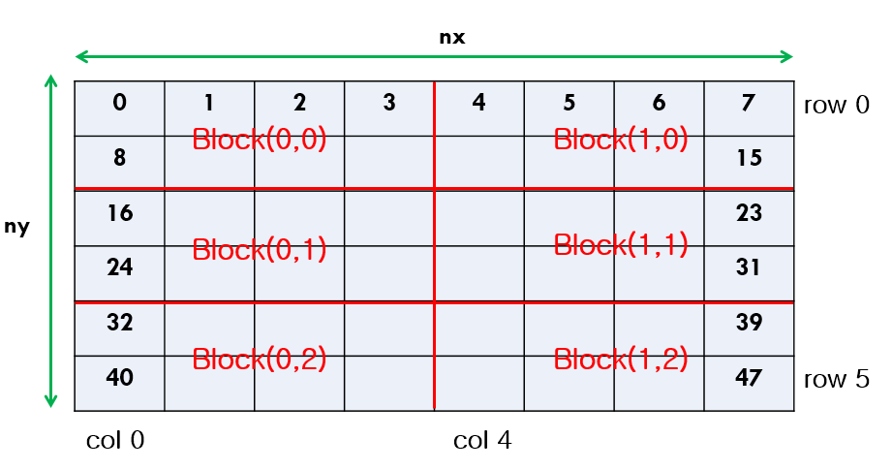
Gaussian Blur: Implementation with CUDA
Implementation with CUDA
Finding the current pixel location

Slide 17
Gaussian Blur: Implementation with CUDA
Implementation with CUDA
Only threads which are inside of the output image size will be active
Output width
Output height
Original Image
Output Image

Slide 18
Gaussian Blur: Implementation with CUDA
Implementation with CUDA
We save Mask filter data in thread register.
(register = the fastest memory)
Because mask filter coefficients are used frequently.

Slide 19
Gaussian Blur: Implementation with CUDA
Implementation with CUDA
One Thread is in charge of the process of the one output image pixel.
Thread (0,0)
Thread (0,0)
Thread (1,0)
Thread (0,1)
Original Image
Output Image

Slide 20
Gaussian Blur: Implementation with CUDA
Implementation with CUDA
This forces the threads to synchronize before executing further instructions.

Slide 21
Gaussian Blur: Implementation with CUDA
Implementation with CUDA
Copies the contents of the Device memory to the Host memory referenced by h_resultPixels

Slide 22
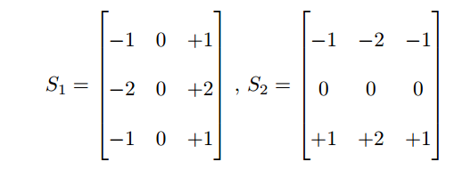
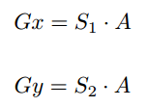
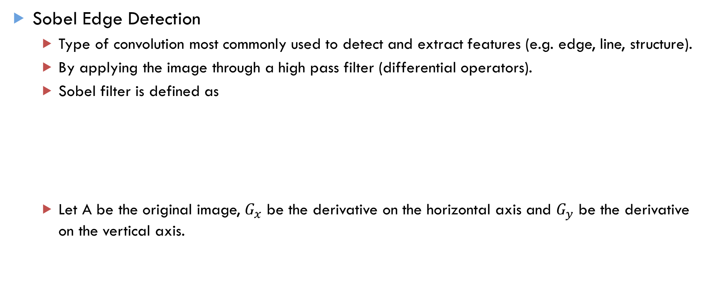
Sobel Edge Detection
Sobel Edge Detection
Type of convolution most commonly used to detect and extract features (e.g. edge, line, structure).
By applying the image through a high pass filter (differential operators).
Sobel filter is defined as
Let A be the original image, $G_{x}$ be the derivative on the horizontal axis and $G_{y}$ be the derivative on the vertical axis.

Slide 23



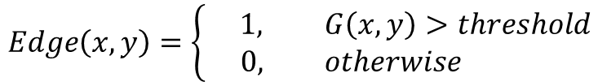
Sobel Edge Detection
Sobel Edge Detection
The resulting gradient image is the combination of $G_{x}$ and $G_{y}$ .
The gradient direction is calculated by
Finally, to determine whether a pixel of the original image A is part of an edge, we apply
$$Edge\left(x,y\right)=\left\{\begin{aligned} 1, G\left(x,y\right)>threshold \\ 0, otherwise \end{aligned}\right.$$

Slide 24
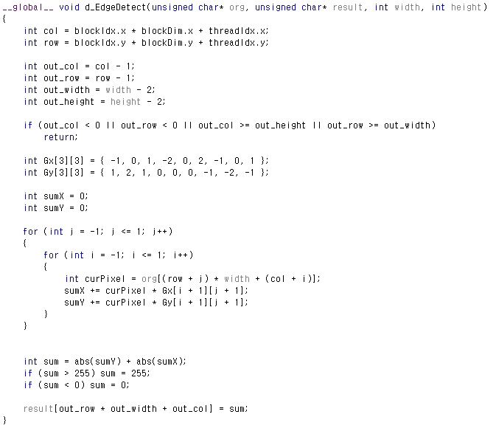
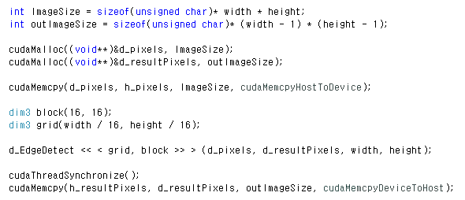
Sobel Edge Detection: Implementation with CUDA
Implementation with CUDA

Slide 25
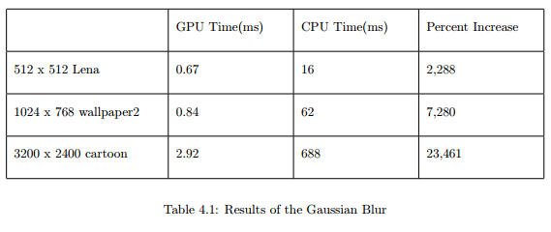
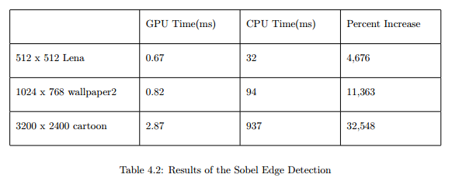
Results
Gaussian Blur
Sobel Edge Detection
22.88%
46.76%
72.80%
113.6%
234.4%
325.4%
512x512 Lena
3200x2400 cartoon
Image size: 29 times bigger
CPU time/GPU time = 22%
CPU time/GPU time = 234%
It affirms the claim that the larger the data, the better the benefits are in using CUDA

Slide 26
Conclusion

Slide 27
Conclusion
Necessity
Large size image processing (e.g. UHD, 4K image) takes lots of time.
Capability
Characteristic of image processing is that it can be processed in parallel independently.
Thus, CUDA GPU programming is useful for the image processing.

Slide 28
Thank you for listening

